Slide 1
Object-Oriented Analysis and Design
Chapters 16: UML Class Diagrams

Slide 2
What will we learn?
UML Class Diagrams – What are they, how to create them

Slide 3
Introduction
UML provides the tools for creating general class diagrams, i.e. static object modeling, that can be used to create Domain Models or software class diagrams
We will look in more detail at the UML notation that can be used, irrespective of the perspective (conceptual or software class)
Note that UML provides a set of diagraming tools, most of which are optional to use
Standardized diagram language, makes it easier to communicate designs
The next slide gives an overview of the concepts we will be discussing in this lecture

Slide 5
UML: Design Class Diagram (DCD)

Slide 6
Classifiers, Attributes
A UML classifier is a model element that describes behavioral and structure features
Think of classes or interfaces
Attributes may also be called structural properties
Attributes may be displayed in several ways in a UML diagram:
Text in a class box
On an association line
Both of the above
Full format for attribute text notation (note most items are optional):
Visibility name : type multiplicity = default {property-string}
Note that Visibility is the +- notation we saw earlier (+ public, - private)

Slide 7
UML: Notating Attributes

Slide 8
Attributes As Associations
Notice that there are subtle differences between the conceptual perspective (Domain Model) and software perspective (Design Model) for attributes that are defined as associations
For DCDs, there is usually
A navigability arrow
A multiplicity at the target end, but not the source
A role name
No association name

Slide 9
UML: Attributes as Associations

Slide 10
Attributes: Text versus Associations
We explored the idea of data type objects earlier (Domain Models)
Data types referred to objects for which individual identity is not important
Recall a Person object versus a Name data type
One guideline is to use the text for data types (basically primitive types) and associations for more complicated classes
Note that this is a diagram preference – does not matter in the final code

Slide 11
UML: Attributes as Associations

Slide 12
Attributes: Lists
How do we notate a list of attributes, e.g. an ArrayList in Java?

Slide 13
Operations and Methods
Operations are usually displayed in the class box with the notation:
visibility name (parameter-list) {property-string}
Sometime a return-type is value is added
Assume public if no visibility is shown
An operation is a declaration (name, parameters, return type, exceptions list)
A method is an implementation of an operation
in sequence diagrams, may show the details and sequence of messages
In class diagram, usually include some pseudo-code in a note with the <<method>> tag

Slide 14
Method Notation in UML
Often times constructors (if included) are notated with the <<constructor>> tag
Usually, getters and setters are ignored in class diagrams
They are assumed to exist, or are added to the code on an as-needed basis

Slide 15
Keywords
Keywords are textual adornments used to categorize a model element – they provide some additional information about the element.
Usually notated <<keyword>>, and sometimes {keyword}
Some examples:
<<actor>> - this entity is an actor
<<interface>> - this entity is an interface
{abstract} – this is an abstract element, it can’t be instantiated
{ordered} – this set of objects is ordered, e.g. the ArrayList example shown earlier

Slide 16
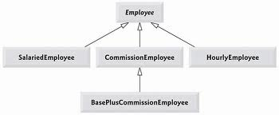
Abstract Classes
As we saw earlier in Domain Models, UML has the ability to denote generalization
Solid line with open, fat arrow; can also notate {abstract} in super-class
It represents a relationship between more general classifier and more specific classifier. The specific classifier indirectly has the features of the more general classifier

Slide 17
Dependency in UML
In UML, dependency lines can be used in any diagram, but they are especially common in class and package diagrams.
In UML, a general dependency relationship indicates that a client element (class, package, use case, etc.) has knowledge of a supplier element and that a change in the supplier could affect the client
Indicated by a dashed arrow from the client to the supplier
Note that we often associate elements with associations (e.g. super- and sub-classes as we just saw), so we do not need to add dependency arrows if an association already exists
Often used when a class has an attribute of another class type, or if one class sends a message to another class

Slide 18
Dependency in UML
Guideline: Use dependency in UML to depict global parameter variable, local variable, and static-method call to another class.
Public class Sale
{
Public void updatePrice(ProductDescription description)
{
Money basePrice = description.getPrice();
….
}
….
}

Slide 19
Dependency in UML
Public class Foo
{
Public void doX()
{
system.runFinalization();
….
}
….
}

Slide 20
Dependency Labels

Slide 21
Composition and Aggregation
We saw this earlier in Domain Models …
Composition is a whole-part relationship between model entities, such that
an instance of the part belongs to only one instance of the composite
a part must belong to a composite
the composite is responsible for creating/deleting the parts. (So if the composite is destroyed, the parts are destroyed or become attached to another composite.)
Aggregation is a weaker form of composition, where the above requirements are not necessarily true
Aggregation does not imply ownership of the parts
Composition involves instantiating objects, aggregation involves pointers to other objects

Slide 22
Composition: Example
Generally look for “has a” associations

Slide 23
Constraints and Qualified Associations
In UML diagrams, a constraint is a restriction on an element
Usually indicated as some text between curly braces in the diagram, either in the class box or next to it
Associations may be qualified – this means the association may depend upon a particular key or parameter.
In the example on the next slide, we see a ProductCatalog that contains many ProductDescriptions. Each one is identified by an itemID.
Note the change in multiplicity in the UML diagram; the association is now related to a single instance, but it is understood that the there may be many associations

Slide 24
Qualified Association

Slide 25
Association Classes
In UML, an association may be considered a class, with attributes, operations, and other features
Include this when the association itself has attributes associated with it

Slide 26
class Company {
Set<Employment> employments;
}
class Employment{
Company company ;
Person person;
Date startDate;
Money Salary;
}
class Person{
Set<Employment> employments;
}
providing a method in Company that returns all its personnels
public Set<Person> getPersonnels () {
Set<Person> result = new HashSet<Person>();
for (Employment e: employments) {
result.add(e.getPerson());
}
return result;
}

Slide 27
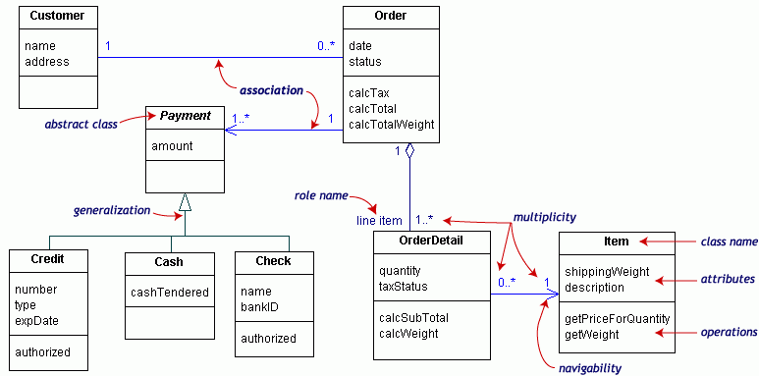

Slide 28
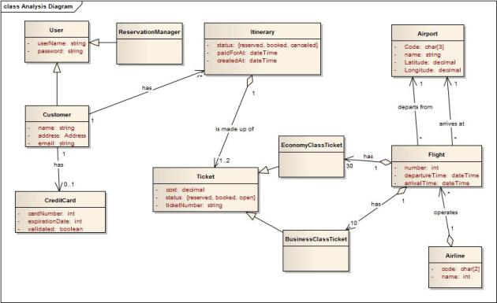

Slide 29
Takeaways from Chapter 16
Understand the basics of reading UML diagrams, in particular with how they represent class diagrams.

Slide 30
Next …
Chapter 15 – Creating interaction diagrams in UML

